Slide 1
ESTATE PLANNING BASICS:WILLS,
TRUSTS AND
POWERS OF ATTORNEY, OH MY!
2022
Tiffany R. Gorton

Slide 3
What About Estate Taxes?
A one-time transfer tax due if the decedents assets reach certain threshold levels.
Washington State Estate Tax Exemption $2,193,000
Federal Estate Tax Exemption $12,060,000

Slide 4
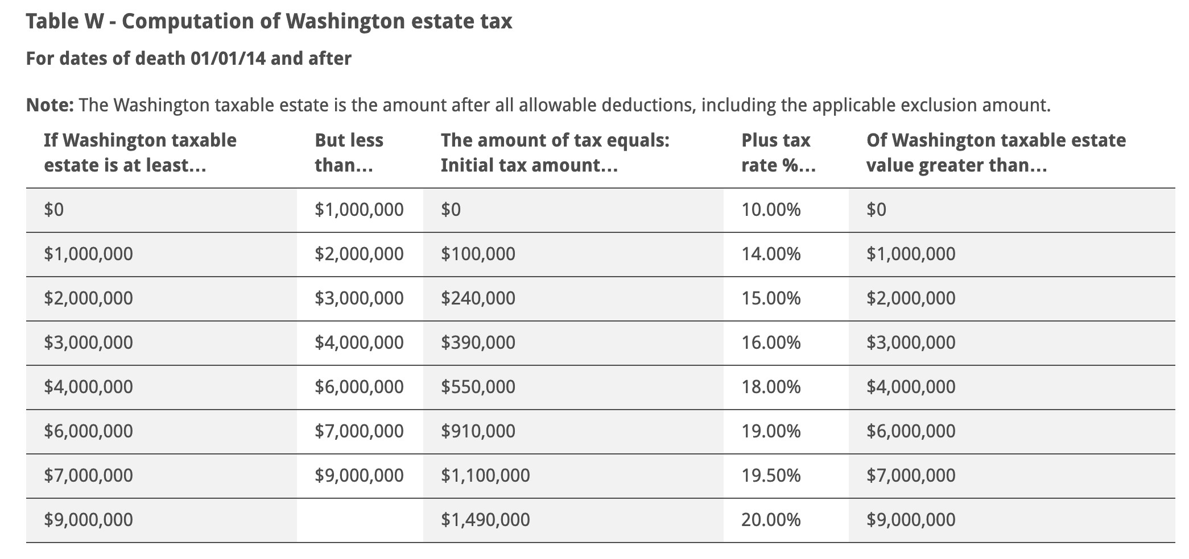
Washington Estate Tax

Slide 5
Federal Estate Tax
For Taxable Estates in This Range | You'll Pay This Base Amount of Tax | Plus This Rate on the Excess Above the Lower End of the Range
$0 to $10,000 | $0 | 18%
$10,000 to $20,000 | $1,800 | 20%
$20,000 to $40,000 | $3,800 | 22%
$40,000 to $60,000 | $8,200 | 24%
$60,000 to $80,000 | $13,000 | 26%
$80,000 to $100,000 | $18,200 | 28%
$100,000 to $150,000 | $23,800 | 30%
$150,000 to $250,000 | $38,800 | 32%
$250,000 to $500,000 | $70,800 | 34%
$500,000 to $750,000 | $155,800 | 37%
$750,000 to $1 million | $248,300 | 39%
$1 million and up | $345,800 | 40%

Slide 6
Durable Power of Attorney
This document takes effect immediately for health care purposes and either immediately or upon incapacity for financial purposes. A durable power of attorney is only effective during your life and loses its effectiveness upon your death. The durable power of attorney allows your agent to handle your finances and work with your health care providers on your behalf while you are still alive but are, for some reason, unable to take care of these things yourself.

Slide 8
Durable Power of Attorney
Requirements for a validly executed DPOA:
Signed
Dated
Acknowledged before a notary OR
Attested by two or more competent witnesses
In the presence of Principal and at Principal’s request or direction

Slide 9
This document is not effective until your death. You can change it at any time during your lifetime. It basically provides a road map for distribution of your probate assets at death. It appoints someone (an executor/personal representative) to gather all of your assets at death and distribute them according to your wishes expressed in your will.
A will is filed with the court after death and a probate may be opened wherein the court formally appoints the executor or personal representative named in your will to distribute your probate assets according to the terms of your will.
Will

Slide 10
Requirements for a validly executed will:
Writing
Signed
By Testator
By two or more competent witnesses
In the presence of the Testator
Will

Slide 11
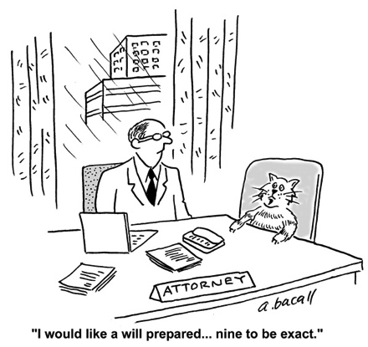
Will

Slide 12
Revocable Living Trust
This document is active during your lifetime and governs distribution of your assets at your death. Like a will, it is completely revocable during your life and you can change it any time. It is essentially an entity that holds title to your assets while you are living. Then, at your death, all the assets held in the trust will be distributed according to the terms of the trust agreement. If properly funded during life, probate proceedings may not be necessary at death.

Slide 13
What is
Probate?
Probate is a court-supervised process of settling a dead person’s (decedent) estate, basically settling debts and transferring assets.
Court gives the personal representative (aka executor) the power to settle the estate by issuing that person Letters Testamentary, which show the rest of the world that the executor has the power to deal with the decedent’s estate.

Slide 14
Probate
Cont.
Executor/Personal Representative/Administrator must:
Gather all the decedent’s probate assets;
Notify and ay the decedent’s creditors;
File tax returns and pay any taxes due;
Distribute decedent’s assets according to the terms of the decedent’s Will

Slide 15
Non Probate Assets
Assets titled as joint tenancy with rights of survivorship
Property subject to a community property agreement
Property held in trust
Life insurance policies
Transfer on death or pay on death accounts

Slide 16
Example Estate Plan
All of the property of John & Jane Doe subject to probate
FIRST DEATH
Decedents ½ of the community property and separate property
Surviving spouses ½ of the community property and separate property
Specific Bequests
Tangible personal property passes first by memo then to surviving spouse.
Survivors Property
Surviving spouses separate property, ½ of the community property & property received decedent. Survivor may disclaim all or a portion of the property received from decedent.
Residue
Residue of decedents estate passes outright to surviving spouse
Credit Shelter Trust
Trust for Surviving Spouse funded with decedents property which surviving spouse disclaimed.
(DISCLAIMED PROPERTY)
SECOND DEATH

Slide 17
Example Estate Plan
SECOND DEATH
Specific Bequests
Tangible personal property distributed first by memo, then to children.
Distribution to Descendants
Balance is held in separate trust for children. Trustee has discretion over income and principal for a child’s health, education support and maintenance. Each child can serve as his own trustee. Each child has a special power of appointment over his trust
Alternate Bequest
One half to John Doe’s heirs and one half to Jane Doe’s heirs

Slide 18
Thank You
Contact
Location
Website
Email: tgorton@khbblaw.com
Phone: 206-382-4414 ​Fax: 206-382-4412
Hoge Building Suite 800 705 Second Avenue Seattle, Washington 98104
khbblaw.com

